Slide 2
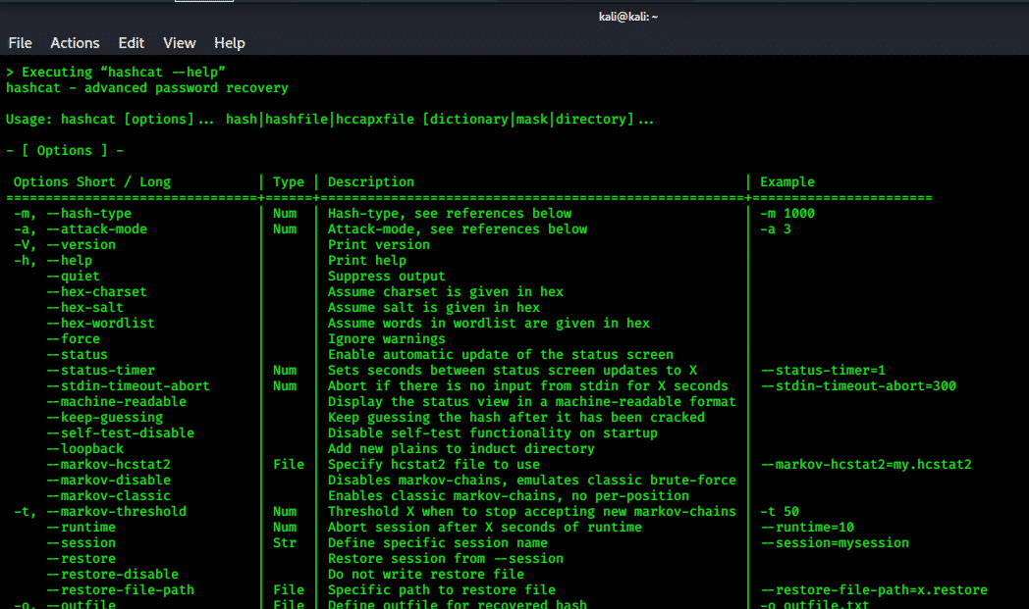
Password Cracking

Slide 3
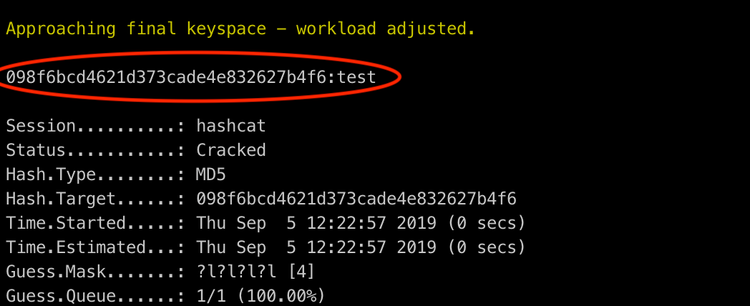
What is Password Cracking?
Password Cracking is the process of recovering passwords from a computer or from data that a computer can transmit.
Usually this takes the form of getting a password hash, and applying various methods to find the original password, but can also be applied to encrypted files such as ZIPs.

Slide 4
Encrypted vs. Hashed
Encrypted: Data that was transformed by some algorithm in order to hide the original data, can be undone.
Example: NevadaCyberClub → ArinqnPlorePyho, with ROT13
This can be reversed by reapplying the algorithm.
Hashed: Data that was transformed by some algorithm in order to hide the original data, can’t be undone.
Example: abc123 → e99a18c428cb38d5f260853678922e03, with MD5
It is mathematically impossible to undo this.

Slide 5
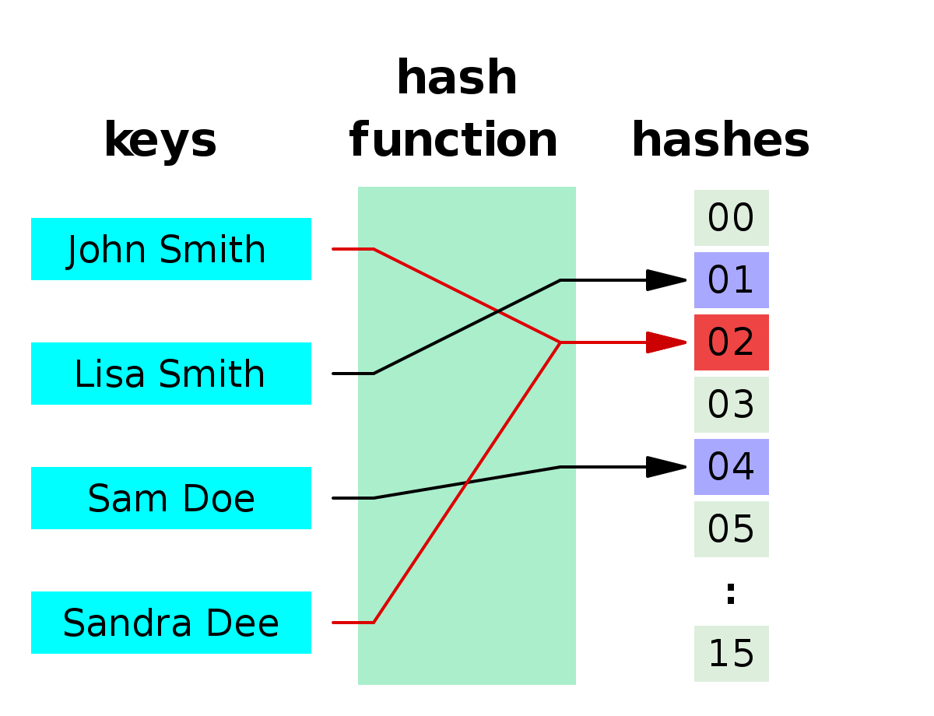
Hash Collisions
The reason that Hashes are impossible to reverse, is because a single hash can be made from multiple different inputs.
A simple example: if x % 5 = 2, what is x? It is impossible to know!
If we were able to find two passwords that gave the same hash, this would be known as a Hash collision. Although it is rare, it is important to note this for later.

Slide 6
What is the use of Hashes?

Slide 7
Some Uses for Hashes
Although not too relevant for what the topic at hand is about, it is useful to know that hashes can be used for verifying the integrity of files. If you make a copy, or download a file, and compare the hash of the new copy to the original, they should match, unless something fishy is happening, or the file is corrupted.

Slide 8
Hashing Algorithms
Outdated/Deprecated:
MD5 and SHA-1 (This is due to them being proven to have multiple collisions)
More Secure:
SHA-256 and BCrypt. (these are longer hashes and less likely to have a collision)
A “Salt”, which is just an extra piece of data (like a randomly generated string) that is appended to the data before it is hashed. It is important to not that this does NOT increase the security of the individual hash as the data is known with the password. The purpose of a salt is so if two people have the same password, it will result in different hashes. If the extra piece of data is not known, then it is referred to as a password “Pepper”.
Some example hashes:
MD5: 92eb5ffee6ae2fec3ad71c777531578f
SHA1: e9d71f5ee7c92d6dc9e92ffdad17b8bd49418f98
BCrypt: $2a$10$q/qpaDHlnXw4ltZY9dRVV.8eVFgMuxQINay26jbgOVGLUF060slP2

Slide 9
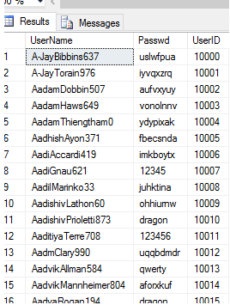
Credential Databases
Whenever a site prompts you to sign up for the first time, your information is usually added to the websites database.
Before hashing, passwords were stored (sadly sometimes still are) in plain text like the left.
This means that if a hacker were able to find an exploit to get into the database, they do not have to do anything else and walk away with free passwords!
This is what happened to RockYou in 2009…

Slide 10
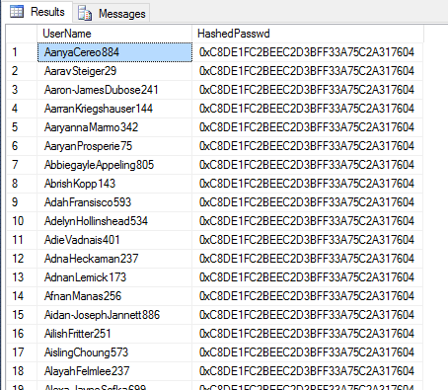
Hashing is the Last Resort
In order to combat a possible data breach, developers started to store passwords as hashes instead. This way it would theoretically be impossible to reverse engineer what the password was.
How it worked: Whenever the user would supply their password, instead of comparing the password, it would hash it and then compare the hash. This also means that if a hash collision was found, you could use the different password that produces the same hash to log in.
This doesn’t mean it’s impossible to get the passwords back…

Slide 11
Meet: Password Cracking
You guessed it! We can use a variety of techniques to figure out what the original password is. This is made possible since the algorithms are made usable by anyone! That way we can put what we think the password is through the algorithm and keep doing it until we get a match! Doing this by hand would be rough…

Slide 12
Programs
Programs can help us automate this process, trying passwords thousands of times faster than we could ever do by hand, some password cracking softwares are:
Hashcat:
This is the fastest password cracking software and the gold standard. It supports many different different hashes, as well as having different rules.
John the Ripper:
If Hashcat is not usable (e.g. zip files), then John the Ripper is used.

Slide 13
Techniques
Bruteforce:
The slowest one; goes through every single physically possible password. Not recommended unless you have no idea.
Masking:
If you have a password idea, but unsure of some characters, you can give a base password and add some “free” characters. (e.g. you know that the password is “ABC” and is followed by 3 unknown numbers, you can run something like ABC?d?d?d)
Wordlist:
If you have a ton of possible passwords (such as commonly used passwords, or the RockYou leak), you can try every one
Hybrid:
Combination of wordlist and masking.

Slide 14
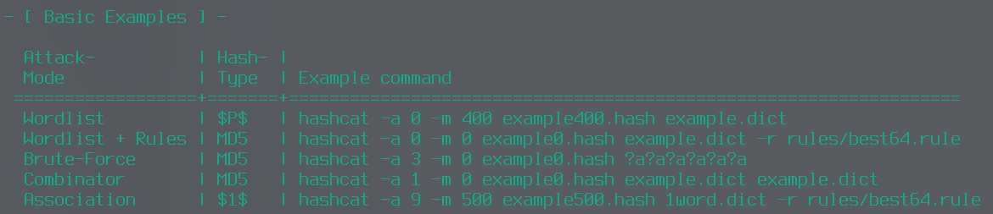
Hashcat
Here are some examples of how to use Hashcat, viewable anytime with the “--help” flag.
Flag meanings:
-a : Attack mode
-m : Hash type
-r : Directory to the rule
Files:
*.hash: Hashed Passwords
*.dict: Wordlist
*.rule: Rule to use

Slide 15
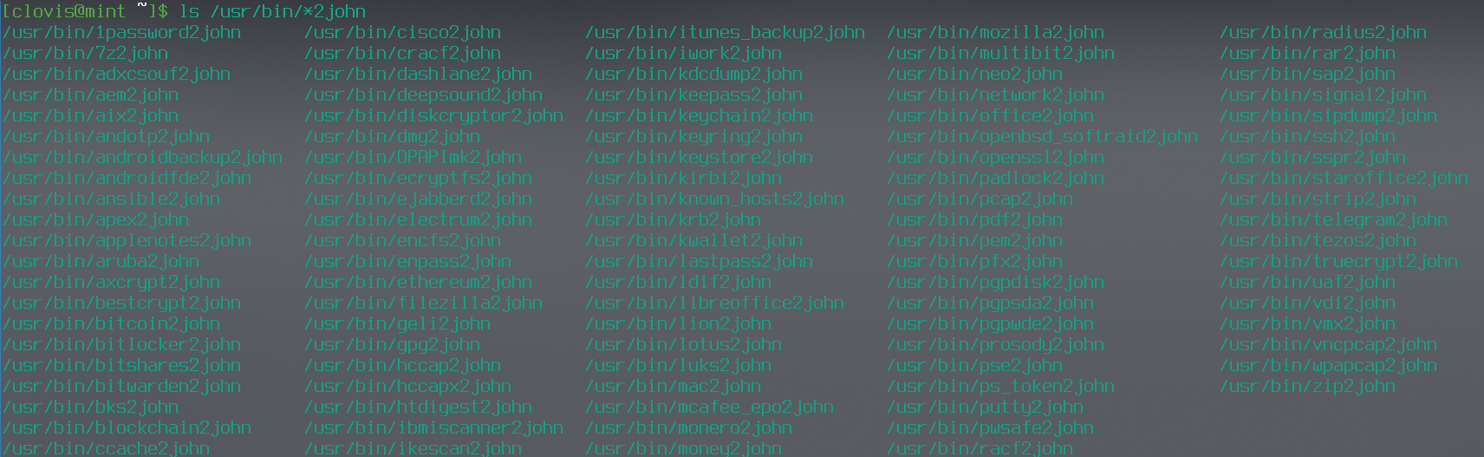
JohnTheRipper
Although Hashcat is faster than JohnTheRipper, Hashcat does not support some hashes, such as ZIP/PDF files, or some obscure ones like Telegram hashes... but John the Ripper does! Here is a huge list of some of the hashes john supports (it is alot). John can also automatically figure out the hash type, and do a lot of work for you.
Flag meanings:
-w : wordlist
--mask : mask
Files:
*.hash: Hashed Passwords
*.dict: Wordlist
*.rule: Rule to use

Slide 16
Let’s get cracking!
https://github.com/NevadaCyberClub/knowledge-base/
Go to Club_Made_Ctf/Challenges/Password_Cracking to get started.

